Slide 1

Fair-Price Decisor
With Transportation Network

Slide 2
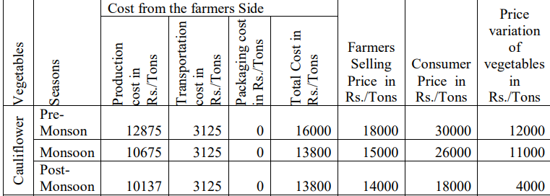
Problem Statement
Farming is said to be the backbone of the country. But Farmers aren't the ones who decide the prices for their product, instead the Middlemen (Series of many) does that which in most cases results in negative trades.
So, the Layers of middlemen can be reduced which can make cost trade off with the transportation but

Slide 3
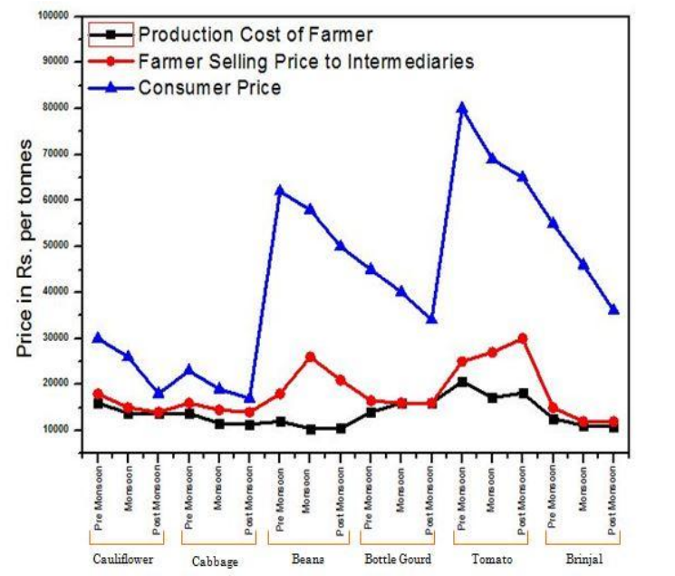
Source : PRICE VARIATION OF VEGETABLES IN DIFFERENT SEASONS WITH REFERENCE TO ORGANIZED RETAILERS
SHAKIL ANWAR SIDDIQUE

Slide 4
Approach to problem
Fixing Fair Price for the producers by predicting future market values of the commodities
Building Better Transportation Network
Fixing better Selling price towards the Retailers
Price
Algorithm
Algorithm
Produce
Warehouse
Warehouse
Retailer
Algorithm
Price

Slide 5
Fixing Fair PRICE
Prediction of the Future Market Values of the Commodities using past Market Prices Using
Regression
A Fair Price is calculated based on the Future Market Value, Production in Area and as Individual, Quality, Upcoming Season
Past Prices
RCNN-LSTM
Simple Model
Regression
Fair Price
Input Parameters

Slide 6
Products to Warehouse
Finding the available Free Warehouse for storing the produce which can accommodate
Mapping towards the Nearest Warehouse for Minimum Transportation using Custom Dijkstra's algorithm
Destination and
Preferred Path
Warehouse Database
Produce
Custom
Algorithm

Slide 7
DISTRICTS TRANSPORTATION
Finding the cost Minimal path to collect the required Goods across districts using Custom Algorithm
Calculating the number of Vehicles and its corresponding required capacity to transport the demanded stocks
Demand
DataBase
Custom Algorithm
Transportation Distribution with Preferred path
Transportation

Slide 8
Warehouse To consumers
Finding the best path to deliver the demand in the areas with the shortest possible way
Best Path To deliver
Warehouse Database
Demand
Custom
Algorithm

Slide 9
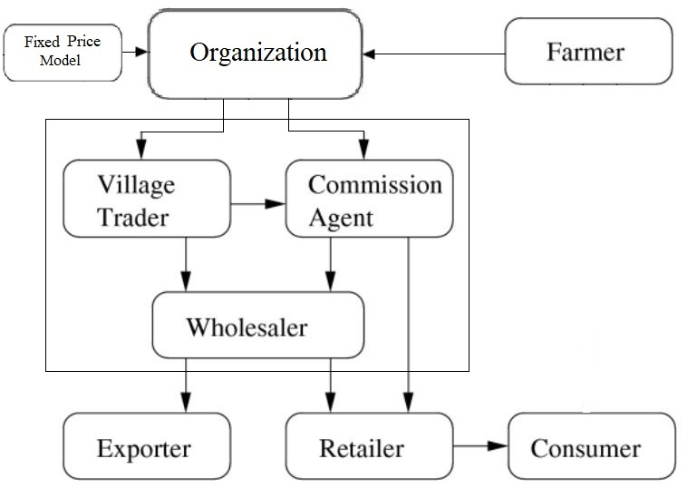
Outcome

